Slide 1
Compiler Hardening Project March 18
Arunabho Basu
Florida Institute of Cybersecurity Research Electrical and Computer Engineering Department

Slide 2
Agenda
Compiler Dependencies
Existing work discussion
Compiler Hardening Flags
Scope of research

Slide 3
Compiler Dependencies
Architecture
Operating System
Language
Vendor
How one compiles can be very different from another.
How do we select/shortlist which ones to use for our research?

Slide 4
Existing Work Discussion
Recently some work has been done to document compiler options and flags that can be used to protect against memory vulnerabilities.
The motivation is to promote secure coding and prevent vulnerabilities at software level.
https://best.openssf.org/Compiler-Hardening-Guides/Compiler-Options-Hardening-Guide-for-C-and-C++.html

Slide 5
Some examples of attacks on memory safety
Buffer overflows
Dereferencing a null pointer
Use-after-free errors
Run-time errors
Microsoft and Google reported as many as 70% of vulnerabilities are memory errors.
Compiler hardening is very effective against these in most use-cases.

Slide 6
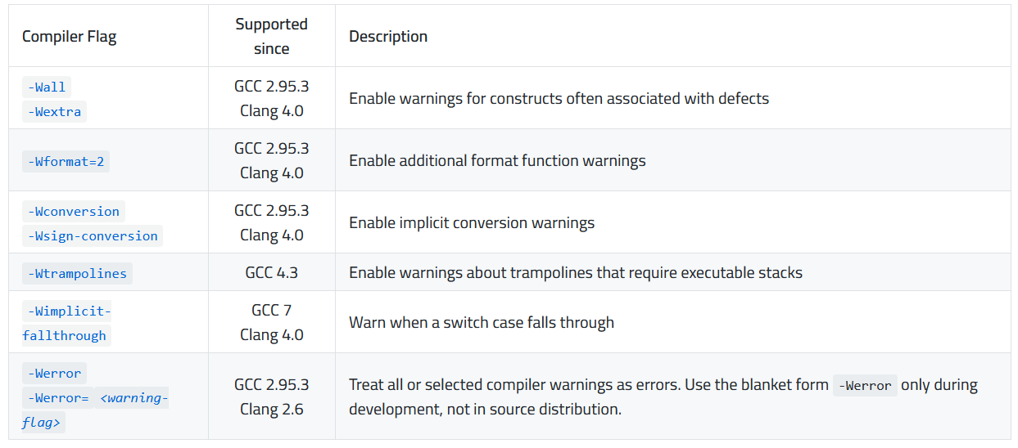
Compiler Hardening – Secure Practices

Slide 7
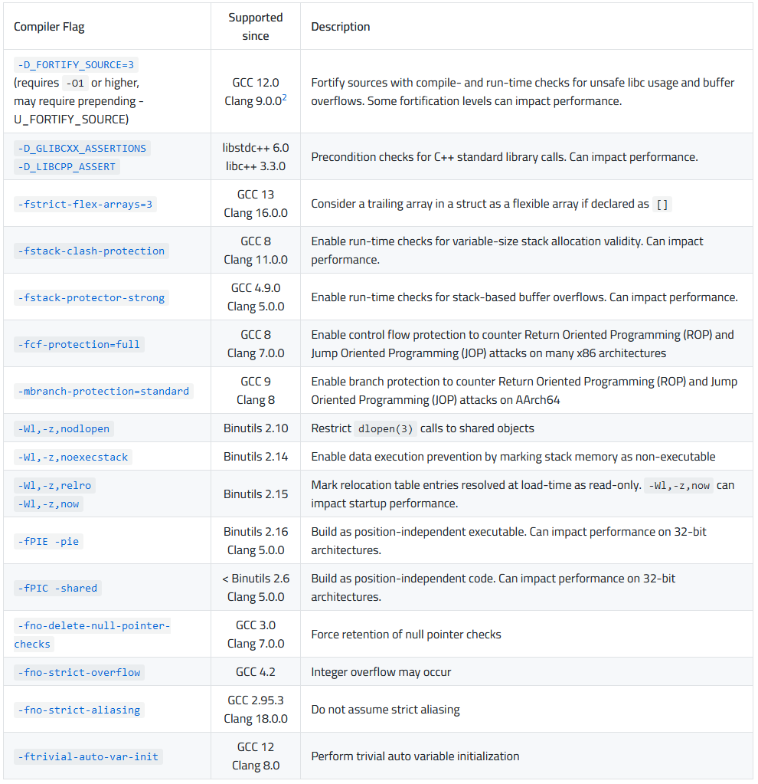
Compiler Hardening – Secure Flags

Slide 8
Research scope
Existing efforts at compiler hardening are only for mitigating memory attacks only.
Existing efforts are architecture agnostic, software focused, leaving us to focus on hardware

Slide 9
Compiler Hardening Project April 5
Arunabho Basu
Florida Institute of Cybersecurity Research Electrical and Computer Engineering Department

Slide 10
Control Flow Integrity (CFI)
Restriction of the flow of control to only legal paths as defined by control flow graph
Ensuring target of every indirect call or jump is a valid destination, as per statically compiled control flow graph
Some examples :
Embedded Checks with Tagged Pointers
Memory is tagged with metadata that can be checked a runtime
Shadow stack or protected stack (Intel CET)
Shadow stack is protected and can detect attempts at stack manipulation
Secure Enclaves (ARM TrustZone, Intel SGX)
Secure areas within the processor for sensitive code and data
Pointer Authentication (ARM PAC)
Adds cryptographic digital signatures to pointers, attackers can’t craft valid pointers

Slide 11
OS level security mech – enforced w/ Hardware
Data Execution Prevention
Marking certain areas of memory as non executable with the help of hardware design.
Restricting code executions from data pages
Known as
Executed Disable (XD) for Intel
No Execute (NX)
Address Space Layout Randomization
Hardware based randomization techniques increases entropy and enhances randomization

Slide 12
Deprecated : Memory Protection Extensions
Intel MPX added capability to do bounds checking for memory access of all pointers and array elements.
Helps programs written in C and C++ which lack bound checking
Helps against memory attacks, buffer overflows/underflows.
Deprecated because of several reasons :
Significant Performance Overhead
Would require complete rewrite of existing codebases
Only supported by GCC

Slide 13
Compiler Hardening Project April 29
Arunabho Basu
Florida Institute of Cybersecurity Research Electrical and Computer Engineering Department

Slide 14
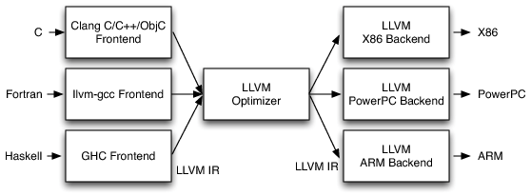
LLVM

Slide 15
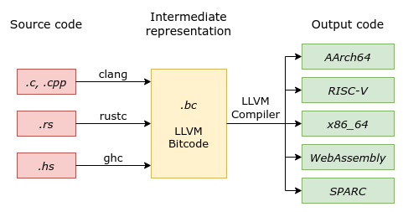
LLVM

Slide 16
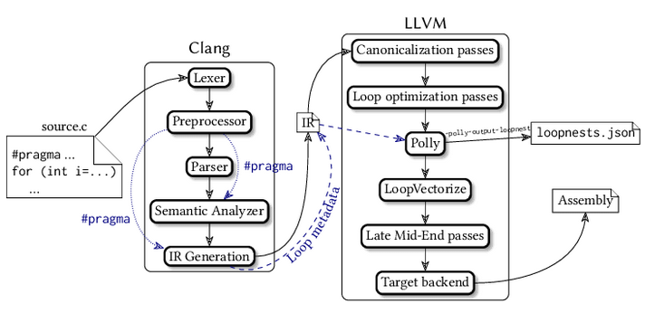
LLVM

Slide 17
Relevant Papers for LLVM based hardening
Julien Proy, Karine Heydemann, Alexandre Berzati, and Albert Cohen. 2017. Compiler-Assisted Loop Hardening Against Fault Attacks. ACM Trans. Archit. Code Optim. 14, 4, Article 36 (December 2017), 25 pages. https://doi.org/10.1145/3141234
H. Winderix, J. T. Mühlberg and F. Piessens, "Compiler-Assisted Hardening of Embedded Software Against Interrupt Latency Side-Channel Attacks," 2021 IEEE European Symposium on Security and Privacy (EuroS&P), Vienna, Austria, 2021, pp. 667-682, doi: 10.1109/EuroSP51992.2021.00050.

Slide 18
Compiler Hardening Project May 31
Arunabho Basu
Florida Institute of Cybersecurity Research Electrical and Computer Engineering Department

Slide 19
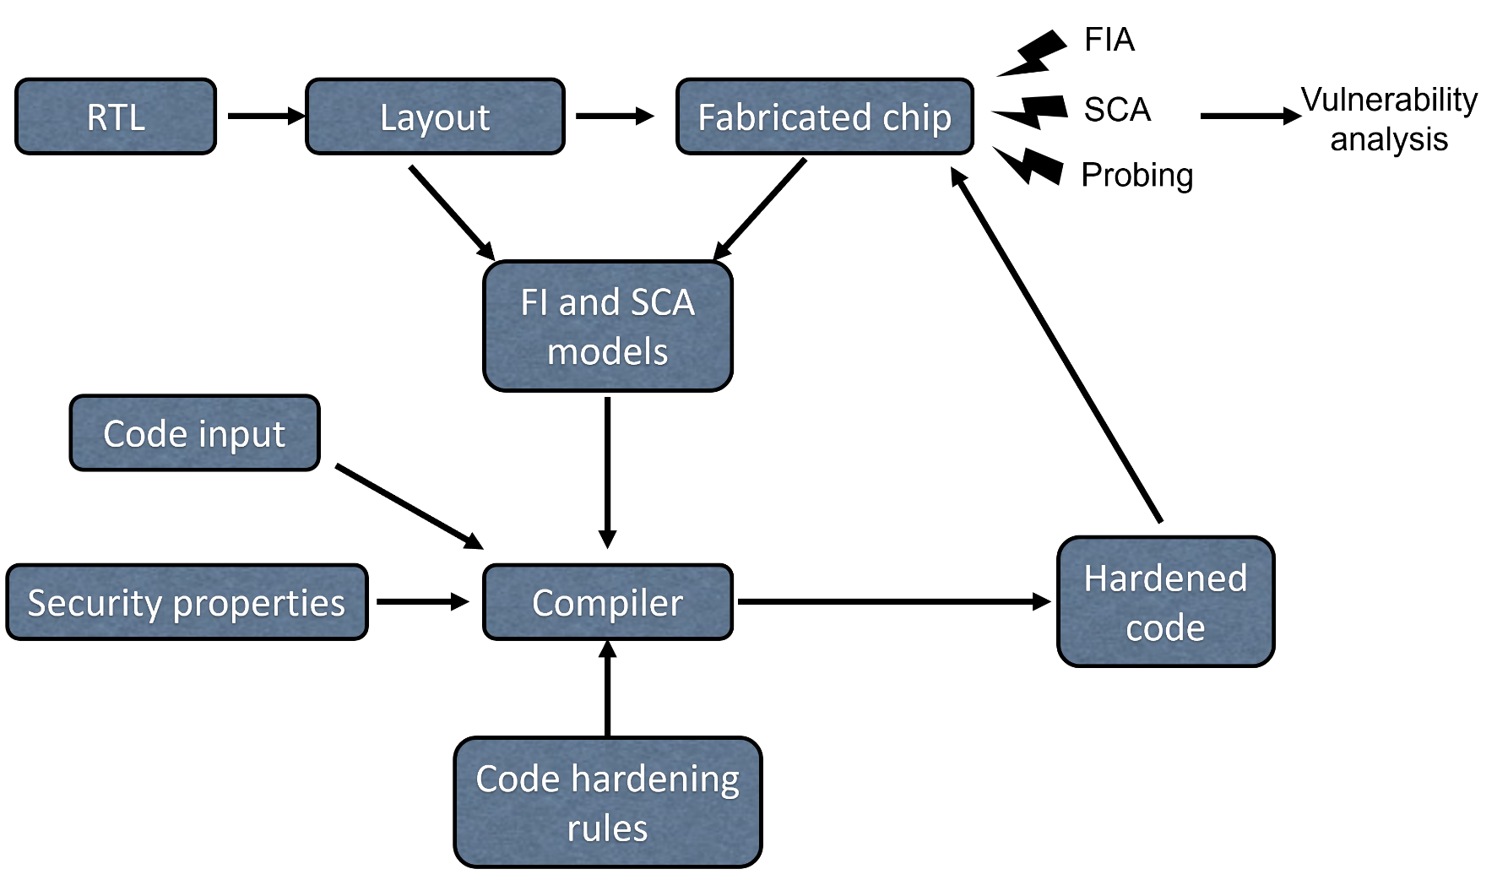
Project Overview
Compiler-based
FIA/SCA Hardened Software

Slide 20
Mapping Compiler Flags to FI/SCA model
GCC Options
Compile time Options
Run time Options
Control Flow Options
Stack Hardening
Function hardening
Jump statement hardening
Loop Hardening
Pointer Hardening
FI/SCA model vectors
FI
Laser
Clock
Voltage
SCA
EM Wave
Power
Time
Attacks which can be detected/prevented by these options

Slide 21
Research Updates Sept 9
Arunabho Basu
Florida Institute of Cybersecurity Research Electrical and Computer Engineering Department

Slide 22
Updates
Finished working on PMU paper – HOST submission
Work on follow up research – commercial applications in real world workload
Finished compiler section of abstract submission for GOMACTECH
Work on GCC compiler plug-in
Exploring LLVM based hardening
Exploring lightweight crypto for secure boot – Firmware security Proposal
One of the key deficiency identified in firmware security was authenticating :
Hardware components involved in boot-up
Firmware version
Firmware integrity

Slide 23

Project Overview
Working on linking FI/SCA model with Compiler Hardening Options
The security properties are implemented using compiler flags available for GCC compiler
Once the flags are set we get a “Hardened Compiler” that can compile hardened code
Compiler-based
FIA/SCA Hardened Software

Slide 24
Mapping GCC Compiler Flags to FI/SCA model
GCC Hardening Options
Compile time Options
Run time Options
Control Flow Options
Stack Hardening
Function hardening
Jump statement hardening
Loop Hardening
Pointer Hardening
FI/SCA model vectors
FI
Laser
Clock
Voltage
SCA
EM Wave
Power
Time
Attacks which can be detected/prevented by these options

Slide 25
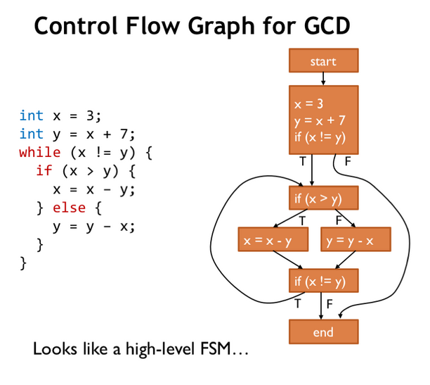
Possible solutions
Extensive post silicon like verification before linking stage - to identify faulty components like registers and cells
Very large overhead
Harden the jump statements with logic fuses?
Harden the control flow graph?
Essentially make the entire CFG a FSM

Slide 26
THANK YOU

